Slide 1
Perpendicular to a given line through a given point
Constructions

Slide 2
how to use Oak lessons

Slide 3
I can use the properties of a rhombus to construct a perpendicular to a given line through a given point.

Slide 4
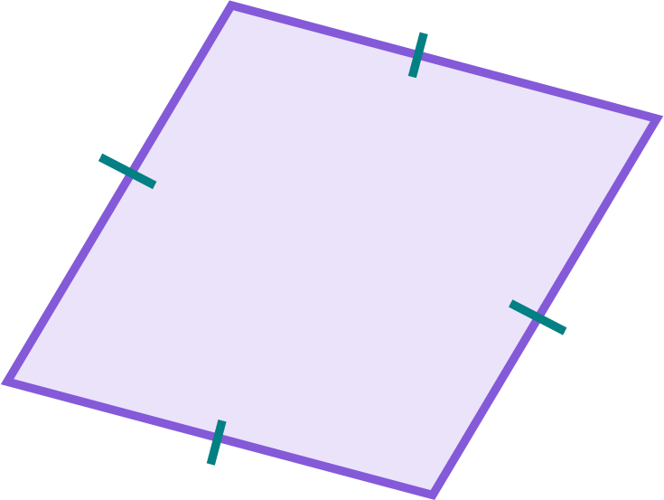
To bisect means to cut or divide an object into two equal parts.
A rhombus is a parallelogram where all sides are the same length.

Slide 5

Perpendicular to a given line through a given point
Perpendiculars at points on shortened line segments
Perpendiculars at points on extended line segments
Perpendiculars through points off a line

Slide 6
Perpendiculars at points on shortened line segments
A perpendicular bisector to AB is a line that intersects the midpoint of AB at a right angle.
But a perpendicular to AB can be any line that intersects at a right angle at any point on the line segment AB.
A
B
A
B
10 cm
10 cm
3 cm
17 cm

Slide 7
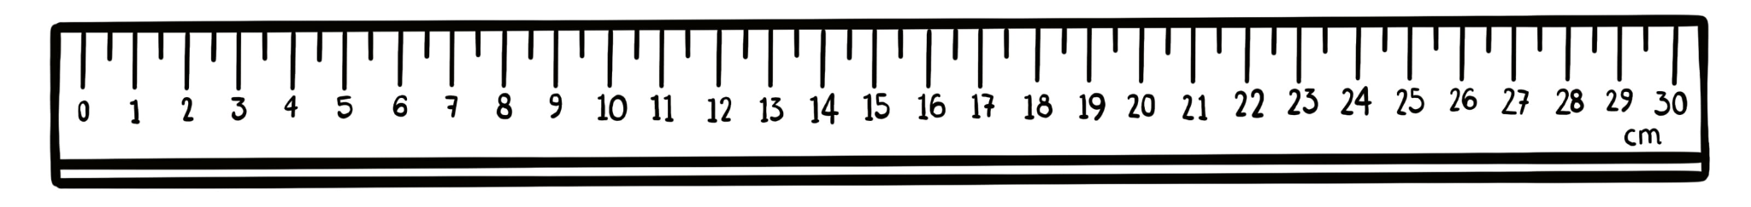
Perpendiculars at points on shortened line segments
It is possible to construct a perpendicular for any point on line segment AB.
The goal is to create a shortened line segment which has the point as the centre of a circle and therefore the midpoint of this shortened line segment.
A
B
5 cm
5 cm
not a midpoint

Slide 8
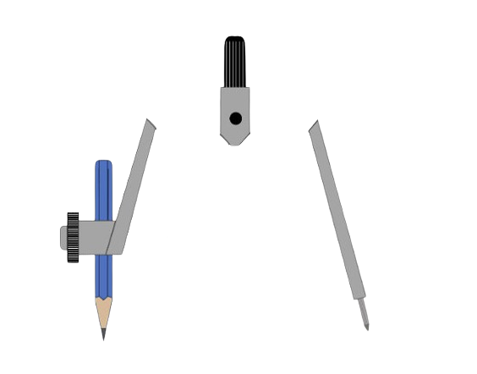
Perpendiculars at points on shortened line segments
Place the compass needle on the point you want to construct a perpendicular through.
Set your compass width to any length where the pencil end touches the line segment either side of the point.
A
B
And then draw a full circle.
The parts of AB outside of the circle can now be ignored.

Slide 9
Perpendiculars at points on shortened line segments
You can now construct a perpendicular bisector using the new line segment inside of the circle.
Place the compass needle on one end of the new line segment and change the width of the compass to greater than half the length of the diameter of the circle.
A
B
Draw two arcs.

Slide 10
Perpendiculars at points on shortened line segments
Draw another two arcs, but this time with the compass needle on the other end of the new line segment.
Make sure the compass width is the same as your previous arcs.
The arcs can intersect anywhere: inside or outside the circle.
The locations of their intersections just depend on how big or small the radii of your arcs are.
A
B

Slide 11
Perpendiculars at points on shortened line segments
Draw a straight line through the two arc intersections to complete the perpendicular through that point.
A
B

Slide 12
Perpendiculars at points on shortened line segments
Construct the perpendicular to an 8 cm line segment AB through point C, which is on AB and 3 cm away from A.
Construct the perpendicular to a 9 cm line segment AB through point C, which is on AB and 4 cm away from A.
I will construct the perpendicular on the left.
After each set of steps, perform the same steps for the construction on the right.

Slide 13
Perpendiculars at points on shortened line segments
Construct the perpendicular to an 8 cm line segment AB through point C, which is on AB and 3 cm away from A.
Construct the perpendicular to a 9 cm line segment AB through point C, which is on AB and 4 cm away from A.
A
C
B
A
C
B
Try it yourself.

Slide 14
Perpendiculars at points on shortened line segments
Place the compass needle on C, and set its width to any length where the pencil end touches the line segment either side of point C.
Construct the perpendicular to a 9 cm line segment AB through point C, which is on AB and 4 cm away from A.
A
C
B
A
C
B

Slide 15
Perpendiculars at points on shortened line segments
Draw a full circle.
Construct the perpendicular to a 9 cm line segment AB through point C, which is on AB and 4 cm away from A.
A
C
B
A
C
B
If your circle is too big, you can just draw another, smaller one.
Try it yourself.

Slide 16
Perpendiculars at points on shortened line segments
Place the compass needle on one intersection between the circle and the shortened AB.
Construct the perpendicular to a 9 cm line segment AB through point C, which is on AB and 4 cm away from A.
A
C
B
A
C
B

Slide 17
Perpendiculars at points on shortened line segments
Extend the pencil end beyond C so that the compass width is over half the diameter of the circle.
Construct the perpendicular to a 9 cm line segment AB through point C, which is on AB and 4 cm away from A.
A
C
B
A
C
B
Draw two arcs, one on each side of the line segment.
Try it yourself.

Slide 18
Perpendiculars at points on shortened line segments
Construct two more arcs with the compass needle on the other end of the shortened line segment.
Construct the perpendicular to a 9 cm line segment AB through point C, which is on AB and 4 cm away from A.
A
C
B
A
C
B
Try it yourself.

Slide 19
Perpendiculars at points on shortened line segments
Draw a line through both intersections of the arcs.
This is the perpendicular to AB through point C.
Construct the perpendicular to a 9 cm line segment AB through point C, which is on AB and 4 cm away from A.
A
C
B
A
C
B
Use a protractor to see how close to 90° this angle is.
Try it yourself.

Slide 20



Perpendiculars at points on shortened line segments
Sofia has incorrectly constructed a perpendicular for AB through C.
What did Sofia do wrong?
A
Sofia
a
The whole diagram has been turned.
The circle is too big.
C
b
c
Sofia hasn’t drawn all the expected construction arcs.
B
d
The line through C may not be perpendicular to AB.

Slide 21
Perpendiculars at points on shortened line segments
1) Complete the construction of the perpendicular through point Z on each line segment.
C
D
Z
E
Z
F
A
Z
B
G
H
Z
J
Z
I

Slide 22
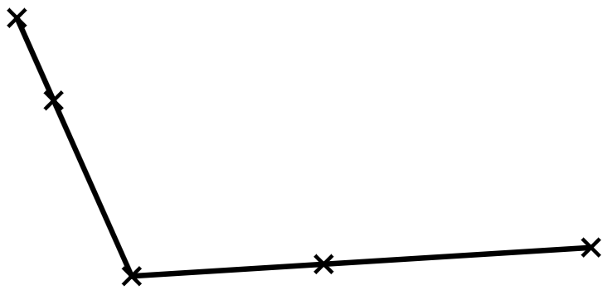
Perpendiculars at points on shortened line segments
2) a) Construct the perpendicular to AB through X and the perpendicular to BC through Y.
b) Label the point where the two perpendiculars intersect Z.
c) Which quadrilateral is bound by vertices XBYZ? Justify why you think the construction creates this shape.
A
X
C
B
Y

Slide 23
Perpendiculars at points on shortened line segments
1) Complete the construction of the perpendicular through point Z on each line segment.
C
D
Z
E
Z
F
A
Z
B
G
H
Z
J
Z
I

Slide 24
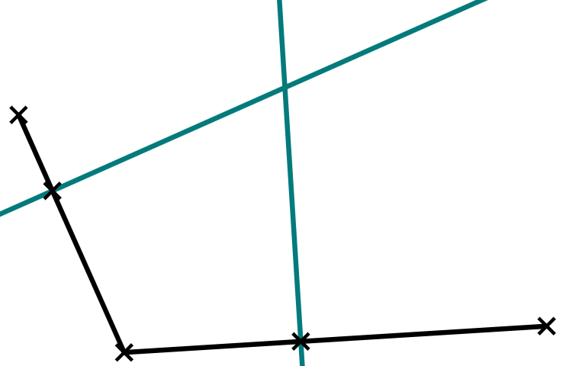
Perpendiculars at points on shortened line segments
2) a) Construct the perpendicular to AB through X and the perpendicular to BC through Y.
c) XBYZ creates a kite. This is because XB = BY, and XZ = YZ.
∠ZXB = ∠ZYB
Z
A
X
C
B
Y

Slide 25
Perpendicular to a given line through a given point
Perpendiculars at points on shortened line segments
Perpendiculars at points on extended line segments
Perpendiculars through points off a line

Slide 26
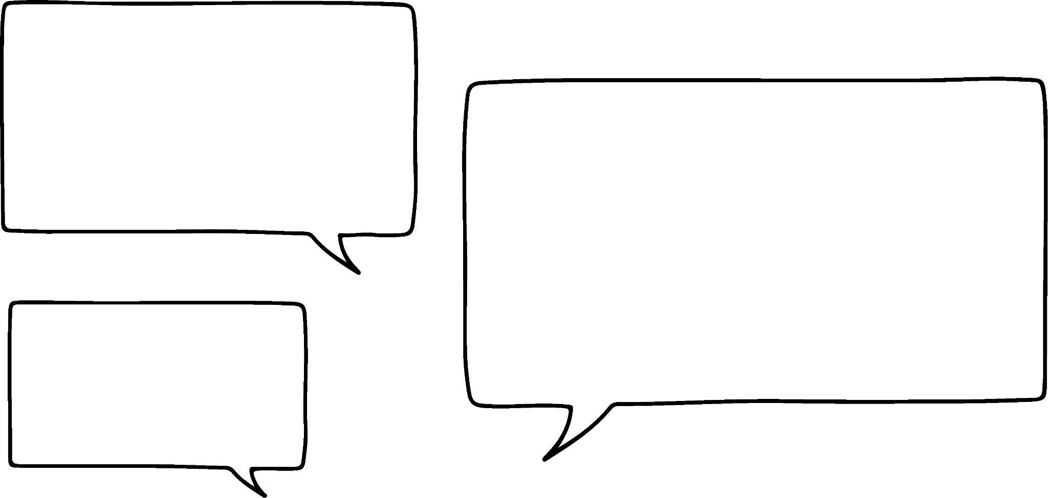


Perpendiculars at points on extended line segments
Because any circle you draw will instantly go off of AB, and the rule was the circle still had to intersect AB exactly twice, right?
I knew some perpendiculars couldn’t be drawn!
What if the point is at the end of a line segment?
Can’t you just draw more of the line segment until it intersects the circle again?
A
B
Jacob
Why is it impossible?
Laura

Slide 27
Perpendiculars at points on extended line segments
Construct the perpendicular to a 4 cm line segment AB through point A.
Construct the perpendicular to a 5 cm line segment AB through point A.
A
B
A
B
4 cm
5 cm
The point we want to construct the perpendicular through is at endpoint A.
Try it yourself.

Slide 28
Perpendiculars at points on extended line segments
Place the compass needle at point A and draw a circle.
Construct the perpendicular to a 5 cm line segment AB through point A.
A
B
A
B
Try it yourself.

Slide 29
Perpendiculars at points on extended line segments
Place your ruler carefully over line segment AB and extend the line segment until it intersects the circle a second time.
Construct the perpendicular to a 5 cm line segment AB through point A.
A
B
A
B
Try it yourself.

Slide 30
Perpendiculars at points on extended line segments
Place the compass needle at one intersection between the extended line segment and the circle.
Construct the perpendicular to a 5 cm line segment AB through point A.
A
B
A
B

Slide 31
Perpendiculars at points on extended line segments
Make the width of the compass needle over half the diameter of the circle and draw two arcs.
Construct the perpendicular to a 5 cm line segment AB through point A.
A
B
A
B
Try it yourself.

Slide 32
Perpendiculars at points on extended line segments
Keeping the compass width the same, repeat with the compass needle at the other intersection.
Construct the perpendicular to a 5 cm line segment AB through point A.
A
B
A
B
Try it yourself.

Slide 33
Perpendiculars at points on extended line segments
The perpendicular is a line that passes through both intersections.
Construct the perpendicular to a 5 cm line segment AB through point A.
A
B
A
B
Try it yourself.

Slide 34
Perpendiculars at points on extended line segments
Extending a line segment is also useful when the point the perpendicular needs to pass through is close to an endpoint.
Without extending the line segment, the circle is far too small to use effectively,
so prioritise extending the line segment so that the circle can be made bigger.

Slide 35


Perpendiculars at points on extended line segments
Whose partially completed construction of a perpendicular that requires an extended line segment is correct?
C
C
Andeep
Sofia
C
C
Alex
Jacob

Slide 36
Perpendiculars at points on extended line segments
1) a) Construct a perpendicular to each line segment through point X.
Decide whether you need to shorten or extend (or both) the line segment.
b) Use a protractor to measure how close each perpendicular is to 90°.
D
X
C
X
E
A
X
B
I
H
G
F
X
X

Slide 37
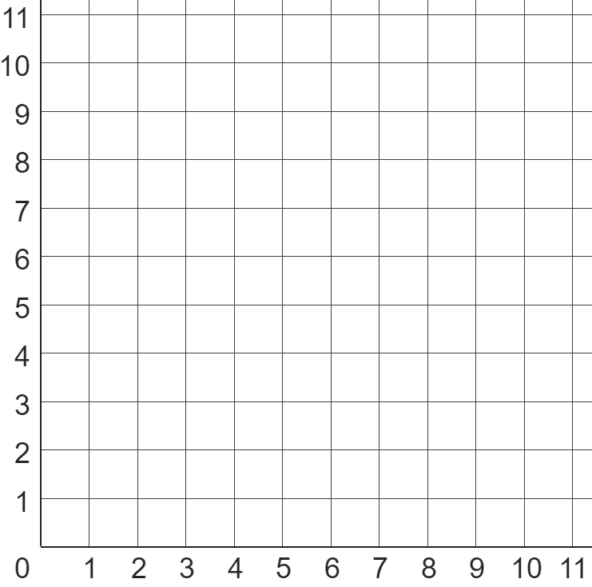
Perpendiculars at points on extended line segments
A(1, 1) | B(5, 3) | C(5, 9) | D(8, 9)
2) Coordinates A, B, C, and D lie on this coordinate grid.
a) Find the perpendicular to AB through the point (3, 2).
b) Find the perpendicular to AC through the point (3, 5).
c) Find the perpendicular to BD through the point (7, 7).
d) Explain which two perpendiculars are parallel to each other and why.

Slide 38
Perpendiculars at points on extended line segments
1) a) Construct a perpendicular to each line segment through point X.
Decide whether you need to shorten or extend (or both) the line segment.
b) Use a protractor to measure how close each perpendicular is to 90°.
D
X
C
X
E
A
X
B
I
H
G
F
X
X

Slide 39
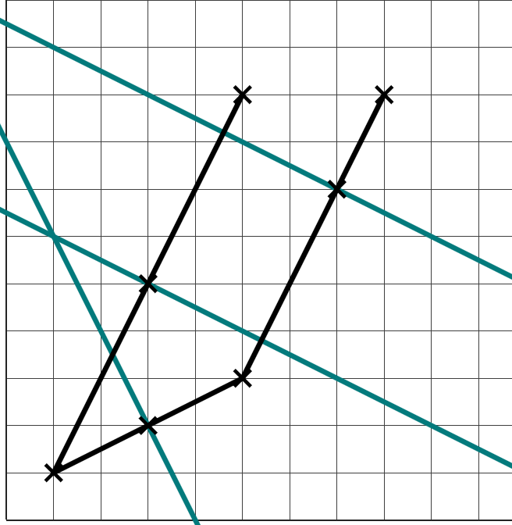
Perpendiculars at points on extended line segments
A(1, 1) | B(5, 3) | C(5, 9) | D(8, 9)
C
D
2) Coordinates A, B, C, and D lie on this coordinate grid.
a) Find the perpendicular to AB through the point (3, 2).
b) Find the perpendicular to AC through the point (3, 5).
c) Find the perpendicular to BD through the point (7, 7).
d) Explain which two perpendiculars are parallel to each other and why.
c)
B
b)
A
a)

Slide 40
Perpendiculars at points on extended line segments
A(1, 1) | B(5, 3) | C(5, 9) | D(8, 9)
C
D
d) Explain which two perpendiculars are parallel to each other and why.
The perpendiculars to AC and BD are parallel to each other because the line segments AC and BD are also parallel to each other.
c)
B
b)
A
a)

Slide 41
Perpendicular to a given line through a given point
Perpendiculars at points on shortened line segments
Perpendiculars at points on extended line segments
Perpendiculars through points off a line

Slide 42
Perpendiculars through points off a line
I don’t think the method will change…
We’ll probably have to extend the line segment, though.
So, no matter where the point we want the perpendicular to pass through is…
We want to draw a circle with that point as the centre that intersects the line segment twice?
Laura
I think so, but what if the point isn’t on the line segment to begin with?
A
B
Jacob

Slide 43
Perpendiculars through points off a line
We can construct the perpendicular to a line segment through a point that’s anywhere: on or off of the line segment.
If the point is off of the line segment, it is more likely that we have to:
draw a bigger circle so that it can reach and intersect the line segment
S
R
extend the line segment so that it intersects the circle twice

Slide 44
Perpendiculars through points off a line
Which of these circles will help in the construction of the perpendicular to QP through point Z?
b
a
c
Z
Extending QP will allow it to intersect with either circle b or c.
P
Q

Slide 45
Perpendiculars through points off a line
1) a) Construct five perpendiculars to AB through each of the five points.
b) Measure the shortest distance from each point to AB.
Y
V
B
A
Z
B
A
X
W

Slide 46
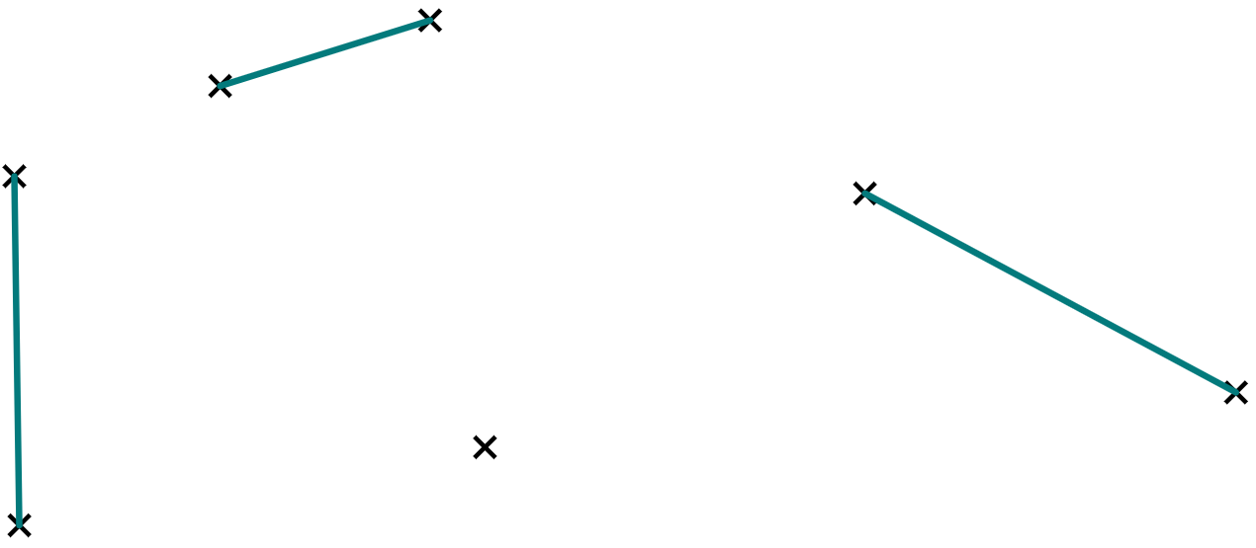
Perpendiculars through points off a line
2) A boat, out at sea, needs to find the closest port so that it can refuel.
Which port is the closest to the boat? And at which part of the port should the boat dock?
Port B
Port C
Boat
Port A

Slide 47
Perpendiculars through points off a line
1) a) Construct five perpendiculars to AB through each of the five points.
b) Measure the shortest distance from each point to AB.
Y
V
B
A
Z
B
A
X
W

Slide 48
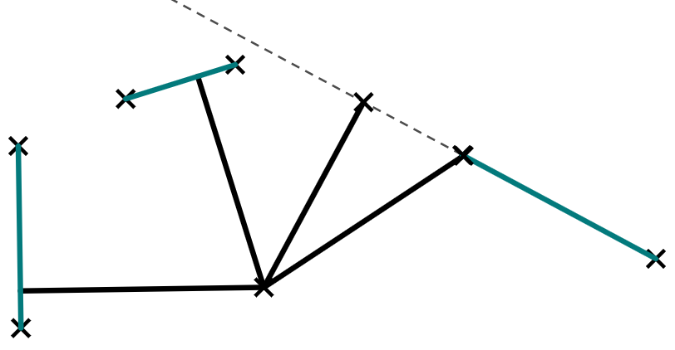
Perpendiculars through points off a line
Port B is closest.
Be careful, as the shortest distance to the extension of port C is closer - but actual port C is further away.
Port B
Port C
Boat
Port A

Slide 49
Perpendicular to a given line through a given point
A perpendicular can be constructed through any point on a line segment, and may require parts of the line segment to be shortened or extended.
It is always possible to construct a perpendicular through any point, as long as:
a circle is drawn with a centre at that point
the circle intersects the line segment twice
A perpendicular can also be constructed through any point off of a line segment.
If a perpendicular through a point off of a line segment intersects the original line segment, then the distance from the point to the line segment is its shortest distance.

Slide 50

© Oak National Academy 2023.
Produced in partnership with Mathematics in Education and Industry.
Licensed on the Open Government Licence v3.0, except where otherwise stated. See Oak terms and conditions.

